Slide 1

DEPARTMENT OF MECHANICAL ENGINEERING
INDIAN INSTITUTE OF TECHNOLOGY (BHU)
VARANASI – 221005
ME-291: EXPLORATORY PROJECT

Slide 2
GROUP-11
Title: Development of 3-D Printed water-based battery
Submitted To:
• Prof Santosh Kumar
Presented by:
• Hritik Mittal (20135049)
• Aditya Katiyar (20135009)
• Naresh Kumar Meena (20135079)
• Keshu Pandre (20135060)
• Kartik Ningaraj Yanigar (20135059)

Slide 3
Introduction
Modern-day society is at present in an alteration phase from a fossil fuel-based economy to the clean energy alternatives required to minimize environmental pollution.
Aluminum–air batteries produce electricity from the reaction of oxygen in the air with aluminum. They have one of the highest energy densities of all batteries, but they are not widely used because of problems with high anode cost and byproduct removal when using traditional electrolytes.
It is also important to search for secure, well-grounded and efficient energy storage technologies with the capability to be used in large-scale applications.

Slide 4
Introduction
3D printing or additive manufacturing is the process of making three-dimensional solid objects from a digital file.
3D-printed batteries have appeared as a class of unique energy storage devices with excellent quality of microscale dimensions and ornamental diversity, which are essential to miniaturized and customized electronics
An aluminum–air water-based battery offers an attractive combination of low cost, lightweight, ultrahigh energy density, and high specific capacity of 2.98 Ah/gAl.

Slide 5
Comparison of Al-air battery costs to internal combustion engines (ICEs)
Cost Component | Current(Al-air) | Projected(Al-air) | ICE’s
Fuel cost (cents/km) | 4.2 | 3.2 | 3.1
Purchase Price (US$) | 20150 | 20150 | 15500
Life Cycle Cost (cents/km) | 26.8 | 25 | 22
https://www.sciencedirect.com/science/article/pii/S2352152X1931391X

Slide 6
Material Used
Multimeter
Aluminium Foil
Copper
Wire
Graphite Powder
Water,
KOH
Paper Towels
Masking Tape

Slide 7
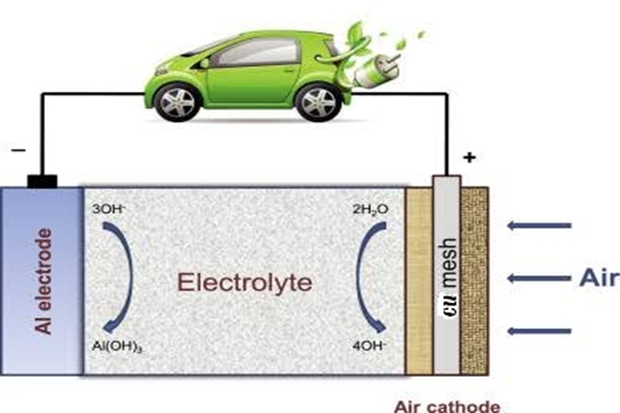
PRINCIPLE OF WORKING OF BATTERY
Al–air batteries create electricity from the reaction of oxygen in the air with aluminium
In the process the aluminium is completely consumed to produce aluminium hydroxide.
They have one of the highest energy densities of all batteries, but they are not generally used because of problems with high anode cost and by-product removal when using traditional electrolytes.
Copper thin films have been commonly recognized for different materials owing to their high-quality magnetic, mechanical, wear resistance, anti-biofouling, and their good electrocatalytic properties
https://www.sciencedirect.com/science/article/pii/S246802571730081X

Slide 8
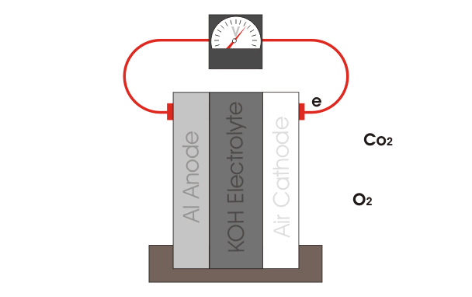
PRINCIPLE OF WORKING OF BATTERY
The anode oxidation half-reaction is: -
Al + 3OH− → Al (OH)3 + 3e− −2.31 V.
The cathode reduction half-reaction is
O2 + 2H2O + 4e− → 4OH− +0.40 V
The balanced equation is
4Al + 3O2 + 6H2O → 4Al (OH)3 +2.71 V

Slide 9
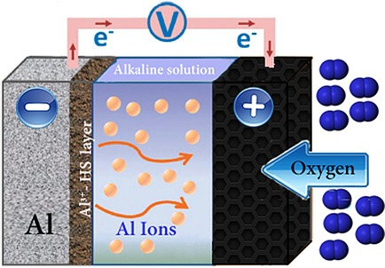
ADVANCEMENT IN TECHNOLOGY
Flax straw extract added to strong alkaline solution acts as a mixed-type Al corrosion inhibitor.
The electrochemistry of Al in the presence of a flax straw extract in the alkaline solution, the effect of the extract on the Al morphology and surface films formed, and the corrosion inhibition mechanism are discussed.
The effect of a flax straw extract on Al corrosion inhibition in a strong alkaline solution was studied by using electrochemical measurements, weight-loss analysis, SEM, and FTIR spectroscopy
The electrochemistry of Al in alkaline solution and in the presence of a flax straw extract added to the alkaline solution, as well as the effect on the Al morphology, surface films formed, and the corrosion inhibition mechanism are discussed
Finally, the Al–air battery discharge capacity recorded from a cell that used the flax straw extract in the alkaline electrolyte is substantially higher than that with only a pure alkaline electrolyte.

Slide 10
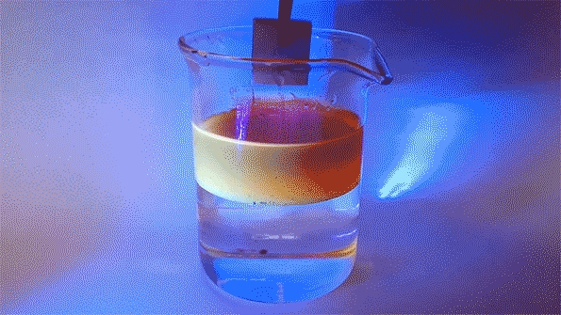
Advancements in technology
Other methods involve pumping the liquid electrolyte out during storage and back in before use.
Because aluminium is hydrophilic (water-attracting) even after the electrolyte is drained out of the pack, the remaining electrolyte will cling to the aluminium electrode surfaces.
The batteries have complex structures, so there are many corners for electrolyte to get caught in, which results in continued corrosion.
These methods still enable significant corrosion and can clog plumbing systems in the battery pack
https://news.mit.edu/2018/metal-air-batteries-extending-life-1108

Slide 11
Advancements in technology
To demonstrate the ability of aluminium to repel oil underwater, the researchers plunged this sample of aluminium into a beaker containing a layer of oil floating on water. When the sample enters the water layer, all the oil that clung to the surface on the way down quickly falls away, showing its property of underwater oleophobicity
A key to the new system is a thin membrane placed between the battery electrodes. When the battery is in use, both sides of the membrane are filled with a liquid electrolyte, but when the battery is put on standby, oil is pumped into the side closest to the aluminium electrode, which protects the aluminium surface from the electrolyte on the other side of the membrane.

Slide 12
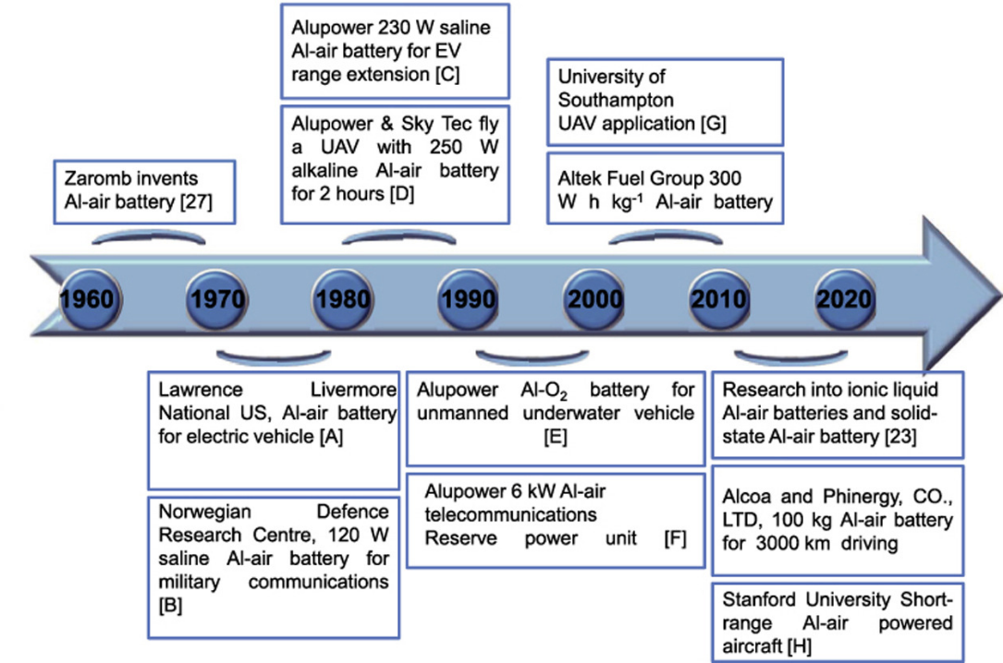
Evolution of Aluminium air battery with time
https://www.sciencedirect.com/science/article/pii/S246802571730081X

Slide 13
Comparison of properties of various metal air batteries:-
Parameter of various metal air batteries are as follows: -
Batteries | Theoretical Voltage (V) | Theoretical specific capacity (Ah Kg⁻¹) | Theoretical energy density (kWh kg⁻¹) | Practical operating voltage (V)
Li–air | 3.4 | 1170 | 13.0 | 2.4
Zn-air | 1.6 | 958 | 1.3 | 1.0-1.2
Mg-air | 3.1 | 620 | 6.8 | 1.2-1.4
Na-air | 2.3 | 687 | 1.6 | 2.3
Al-air | 2.7 | 1030 | 8.1 | 1.2-1.6
https://www.sciencedirect.com/science/article/pii/S246802571730081X

Slide 14
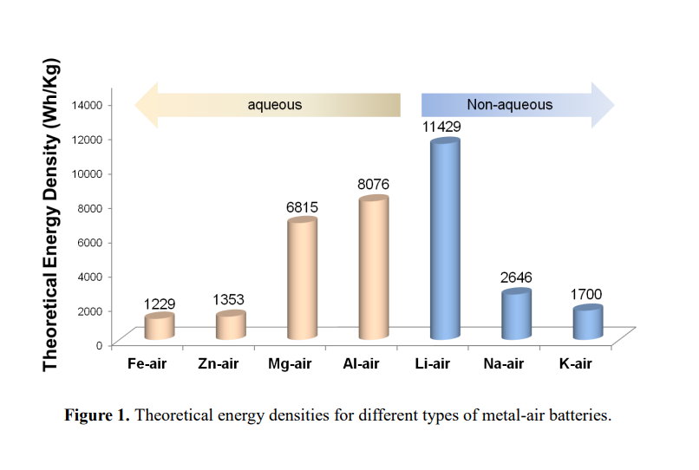
ENERGY DENSITY OF VARIOUS METAL-AIR BATTERIES

Slide 15
ENERGY DENSITY OF VARIOUS METAL-AIR BATTERIES
Among the metal–air batteries shown in Table, the Li–air battery shows the highest theoretical energy density (13000 Wh kg⁻¹), which is significantly greater than other rechargeable battery technologies.
Additionally, aluminium is an inexpensive, abundant and environmental friendly metal with high recyclability . The Al–air battery has a high theoretical voltage (2.7 V) and energy density (8.1 kWh kg⁻¹), far surpassing that of state-of-the-art LIBs.
Among the previously discussed metal-air batteries, Al–air batteries hold great promise for future large-scale energy applications due to their lowest cost and high theoretical specific capacity of 2.98 Ah g⁻¹, which is the second-highest only to that of lithium (3.86 Ah g⁻¹) and much higher than those of magnesium (2.20 Ah g⁻¹) and zinc (0.82 Ah g⁻¹).

Slide 16
Advantages of Aluminium-Air Battery
Low environmental impact
Lighter weight
Cheaper
Safety
No need of external power

Slide 17
Disadvantages of Aluminium-Air Battery
Aluminum–air batteries are primary cells, i.e., non-rechargeable. Once the aluminum anode is consumed by its reaction with atmospheric oxygen at a cathode immersed in a water-based electrolyte to form hydrated aluminum oxide, the battery will no longer produce electricity
An aluminum-air battery would have to be taken to a battery swap station which is a big Disadvantage.

Slide 18
RESULT
First, we prepare a single cell and measured its voltage and it found to be 0.41V. After that we prepare another 13 cells. We connected all the cells in series connection.
Furthermore, the study also suggested that a hydrophilic cathode is favorable to enhance the liquid-electrode contact and increase the performance of the battery.
High amounts of OH− ions are available in the electrolyte solution and react with aluminum at the anode to generate electricity. It also helps to reduce the resistance to ion movement in the separator. Therefore, a compromise exists between the electrolyte concentration, discharge capacity, and operating voltage of an aluminum-air battery.
Measuring the weight of aluminum anodes before and after the electrochemical process can help to understand the corrosion rate of aluminum anodes. Since the density of aluminum hydroxide (2.42 g /cm^3) is lighter than that of aluminum (2.70 g /cm^3), the weight loss can be attributed to the formation of aluminum hydroxide during the electrochemical process.

Slide 19
Voltage vs Number of cells graph
RESULT
In the above graph we have shown the effect of voltage on increasing the number of cells in a battery. All the cells are connected in series connection

Slide 20
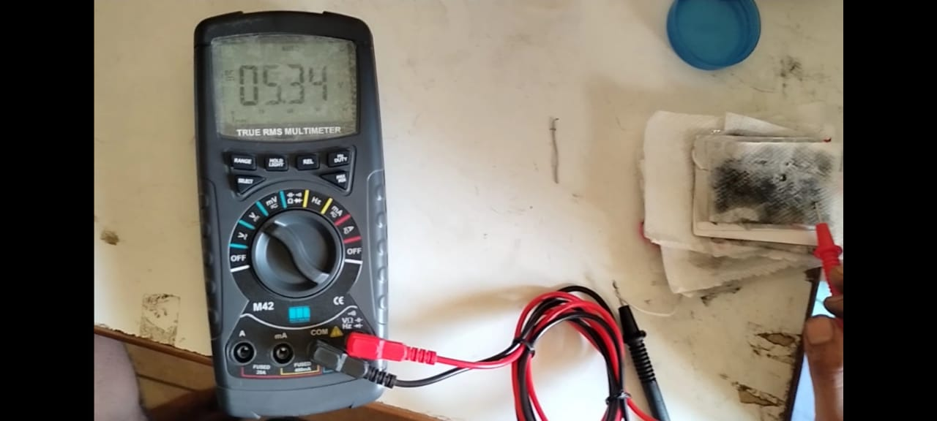
RESULT
Overall Voltage of Battery measured by multimeter

Slide 21
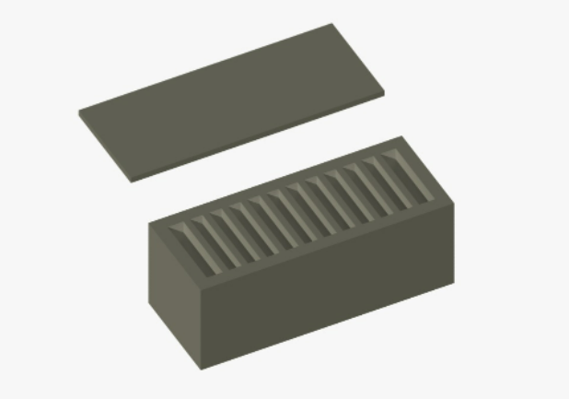
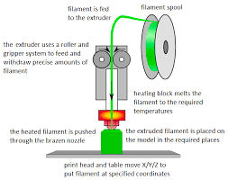
CASING OF BATTERY
3D printing of advanced batteries has drawn considerable attention as an innovative technology that can disruptively change the design and architecture at all levels of materials, modules, and devices.

Slide 22
References -
Zhiyang Lyu, Gwendolyn J.H. Lim, J. Justin Koh, Yi Li, Yanwen Ma, Jun Ding, Jinlan Wang, Zheng Hu, John Wang, Wei Chen, Yunfei Chen,
Design and Manufacture of 3D-Printed Batteries, Joule,
Volume 5, Issue 1,
2021,
Pages 89-114,
ISSN 2542-4351,
https://doi.org/10.1016/j.joule.2020.11.010.
(https://www.sciencedirect.com/science/article/pii/S2542435120305183)
Yisi Liu, Qian Sun, Wenzhang Li, Keegan R. Adair, Jie Li, Xueliang Sun,
A comprehensive review on recent progress in aluminum–air batteries, Green Energy & Environment,
Volume 2, Issue 3,
2017,
Pages 246-277,
ISSN 2468-0257,
https://doi.org/10.1016/j.gee.2017.06.006.
(https://www.sciencedirect.com/science/article/pii/S246802571730081X)

Slide 23
References -
P. Goel, D. Dobhal, R.C. Sharma,
Aluminum–air batteries: A viability review, Journal of Energy Storage,
Volume 28,
2020,
101287,
ISSN 2352-152X,
https://doi.org/10.1016/j.est.2020.101287
(https://www.sciencedirect.com/science/article/pii/S2352152X1931391X)
https://www.sciencedirect.com/science/article/pii/S246802571730081X
https://www.cei.washington.edu/wp-content/uploads/2018/12/Aluminum-air-battery.pdf
https://www.researchgate.net/publication/245105485_Design_and_analysis_of_aluminumair_battery_system_ for_electric_vehicles

Slide 24
Thank You

